Slide 1
Introduction to Machine Learning!
Aviral Mansingka
amansin@purdue.edu

Slide 2


Little about me
I’m a junior graduating a year early with 6 tracks (points for guessing)
Started learning about machine learning and neural networks little more than a year ago
Interned at Yelp’s Data Mining and Search team, Microsoft PowerPoint!
Built a neural network to stylize images in pretty ways

Slide 3
Goal/Motivations of the series!
Get hands on experience with Deep Learning
Experience with frameworks for dealing with data (possibly the big variety)
Practical knowledge in building models from scratch with plenty of examples
Numpy, scikit-learn, tensorflow, keras, etc.

Slide 4
Funky Applications
“A neural algorithm of artistic style” (Shown earlier)
Facebook’s facial recognition, Self Driving Car etc.
Relies mostly convolutional neural networks (CNNs), something we might be able to learn about
Predicting Diseases with IBM Watson

Slide 5
So… that’s why they are awesome!

Slide 6
Sky-high overview of the Series!
Week 1: Introduction to Machine Learning + basics (Chapter 1-5)
Week 2: Neural Networks + secret project (Chapters 6-8)
Week 3: Convolutional Neural Networks + secret project (Chapter 9)
Week 4: Recurrent Networks and LSTMS + secret project (Chapter 10-11)
Week 5: ~

Slide 7
Structure of each talk!
VERY INTERACTIVE!
Discussion of chapter (loosely)
Theory (~1 hour):
High level overview of concepts
Deep dive into some aspects I think are going to be important
Code samples embedded
Fun project (rest):
From scratch!
Using minimal libraries
Summary of everything we learned this week.

Slide 8
Additional Contact Information
Email:
amansin@purdue.edu
Anonymous Feedback:
https://aviralmansingka.sarahah.com/

Slide 9
What’s Machine Learning
Mitchell, 1997:
“A computer program is said to learn from experience E with respect to some class of Tasks T and performance measure P, if its performance at tasks in T, as measured by P, improves with experience E”

Slide 10
What’s Machine Learning
Task
Performance Measure
Experience

Slide 11
Task
”What do you want your model to output?”
NOT LEARNING
E.g. handwritten digit recognition, image classification, price prediction

Slide 12
Task
Classification
Regression
Etc.

Slide 13
Performance Measure
Primary model of evaluating how good we are. (Accuracy)
E.g. zero-one loss, error-rate
Raises important questions about evaluating our results
Generalization!

Slide 14
Experience
Terminology:
example: single point of data. E.g. (Aviral, Junior, …)
dataset: collection/list/array or points
Input: generally denoted ‘x’
Output: generally denoted ’y’
Unsupervised learning: Discover the structure of the dataset
We wish to know p(x,y)
Supervised learning: Given some part of dataset, predict what the other part is.
We wish to know p(y|x)

Slide 15
What’s Machine Learning?
Model:
Probability distribution
Supervised: X: -> f(X; W)
The W is the weights of the model
There are 2 things that define the model:
The type of function used to map inputs to output
The weights that characterize the function
E.g. f(X, [w1, w2]) = w1*X[0] +w2*X[1] OR f(X, [w1, w2]) = w1*(X[0]*X[1]) + w2

Slide 16
What’s Machine Learning
CONGRATS!!
You have all taken your first step in understanding more about this illustrious field!
Let’s take a deep dive into an example of a model

Slide 17
Logistic Regression
Supervised model for binary classification.
Let’s visualize some data!
Its learning procedure is described as convex optimization (more on this later).

Slide 18
Background Knowledge
Basic Linear Algebra (Dot Products)!
Chain rule!
Basic functions
THAT’S IT!

Slide 19


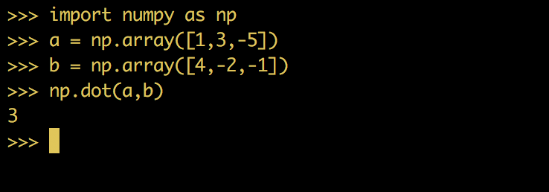
Dot Products

Slide 20
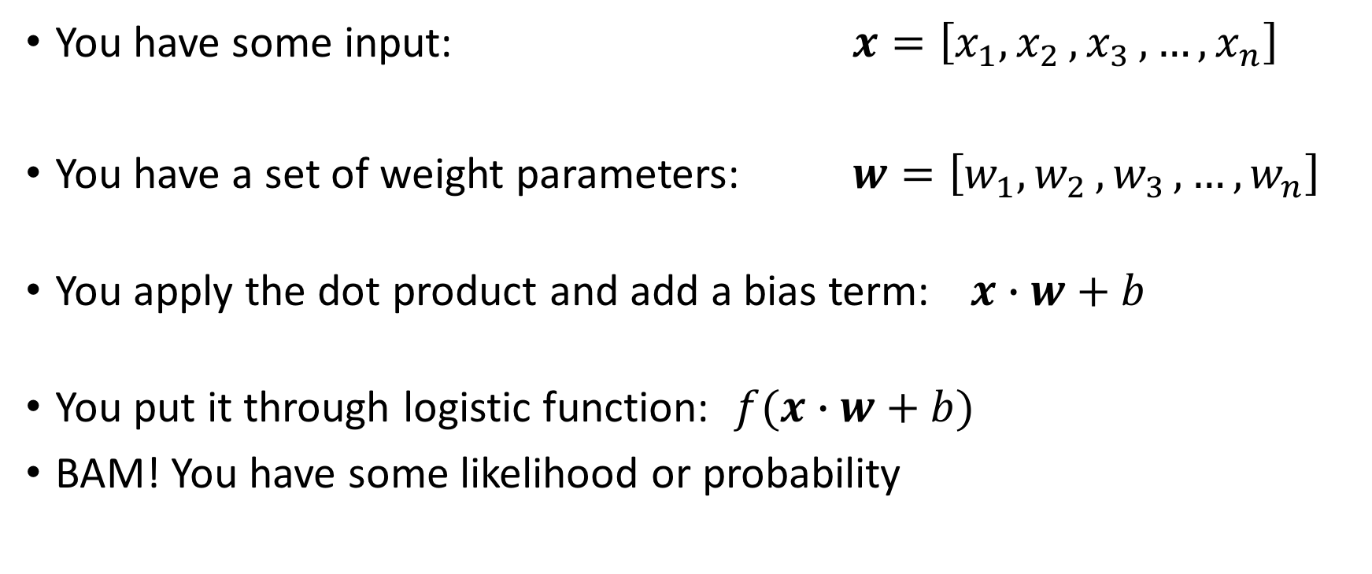
How does logistic regression work?
You have some input: $x=\left[x_{1}{,x}_{2}{,x}_{3},…,x_{n}\right]$
You have a set of weight parameters: $w=\left[w_{1}{,w}_{2}{,w}_{3},…,w_{n}\right]$
You apply the dot product and add a bias term: $x∙w+b$
You put it through logistic function: $f(x∙w+b)$
BAM! You have some likelihood or probability

Slide 21
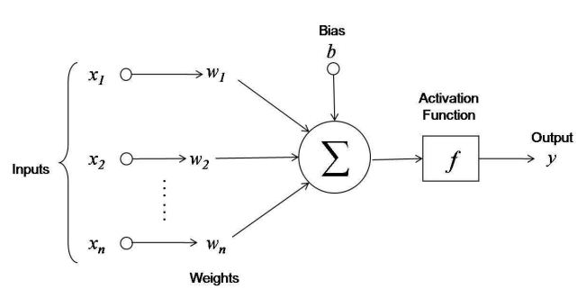
How does logistic regression work?

Slide 22
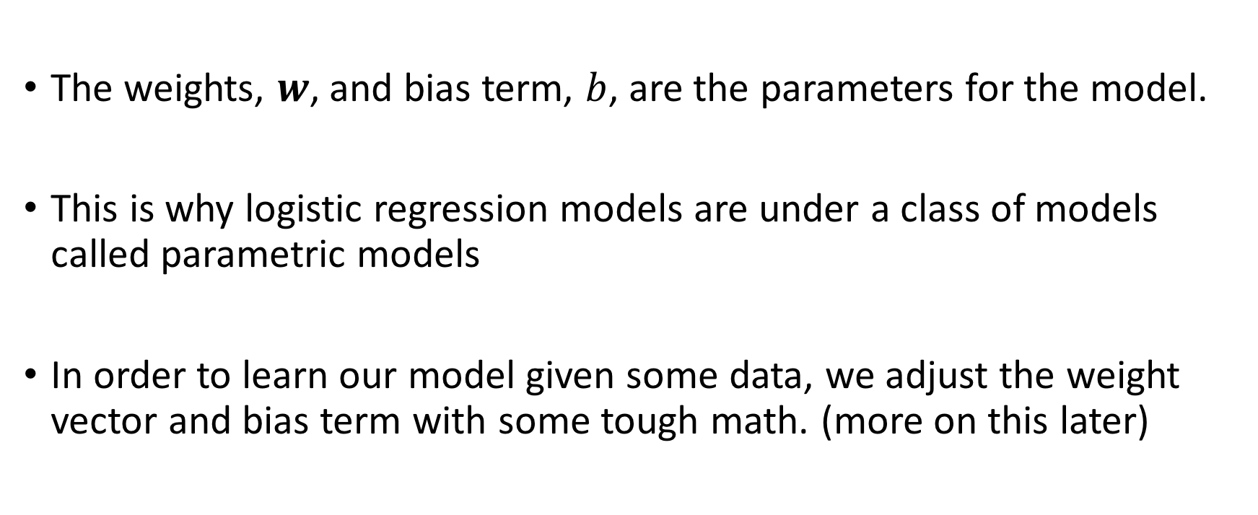
How does Logistic Regression work?
The weights, $w$, and bias term, $b$, are the parameters for the model.
This is why logistic regression models are under a class of models called parametric models
In order to learn our model given some data, we adjust the weight vector and bias term with some tough math. (more on this later)

Slide 23
Let’s talk application
So far we have learned about:
Models
Inputs
Class outputs
A machine learning algorithm needs something else, a loss function
It describes how far we are from our solution
Using this tensorflow will automatically update our parameters using Gradient Descent

Slide 24
Let’s talk application
Very popular neural networks framework called tensorflow
Using an idea called symbolic math, and ‘building a graph’ of computations
It’s super easy! But we aren’t going to do that ☹
We are going to build everything from scratch using NumPy, a fast numerical computation library in python.

Slide 25
How to tell if your friends like you?
Task?
Performance?
Experience?
Model?

Slide 26
How to tell if your friends like you?
Task:
Given a sentence, we want to know if it is ’positive’ or ‘negative’.
For all sentences, we simply add this up and if it’s greater than 0, we are overall ‘positive’, else ‘negative’
Performance:
We want to select weights such that the probability of generating our data is maximized (called Maximum Likelihood Estimation)
Experience:
We are going to train our model on a subset of strongly worded reviews
Apply the learning from that to general sentences
How are we going to ‘learn'?

Slide 27
How to tell if your friends like you?
How to input sentences in our model? Discuss.
Converting the raw input into something the model can understand is called its representation
It’s its own field of study (representation learning/feature engineering).

Slide 28
How to tell if your friends like you?
So far we have talked about getting the gradient, now we use it
Learning:
We use a form of optimization called gradient descent.
Given some function and some inputs, we:
calculate the gradient of the function at those points. (gradient calculation)
Sum them up.
We update our weights in the direction of the gradient! (update rule)
How do we calculate the gradient?
Math!

Slide 29
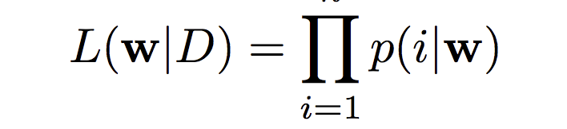
Calculating the Gradient of Logistic Regression
Maximum Likelihood Estimation (MLE):
Given some weights, how likely are we to generate the data?
We want to maximize this by changing weights.
MATH WARNING!

Slide 30
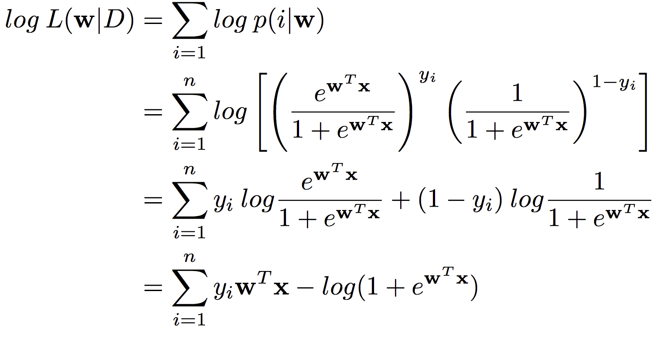
Calculating the Gradient of Logistic Regression

Slide 31
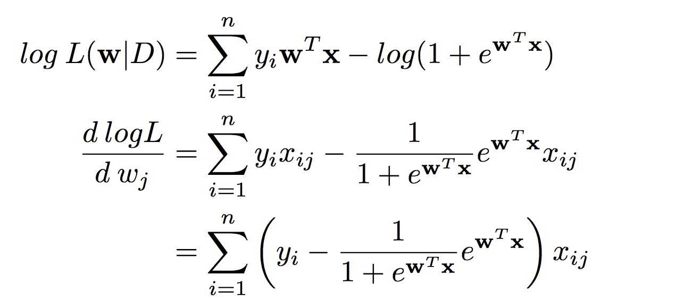
Calculating the Gradient of Logistic Regression

Slide 32
Update rule
We update our weights using the following strategy:
W = W – [ (gradient) * (learning rate) ]

Slide 33
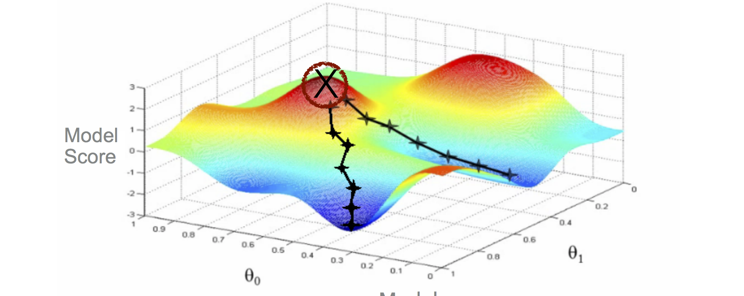
What does gradient descent look like?

Slide 34
Code Sample!
Armed with all this information, we can build our own model from scratch

Slide 35
Additional Contact Information
Email:
amansin@purdue.edu
Anonymous Feedback:
https://aviralmansingka.sarahah.com/

